Slide 1

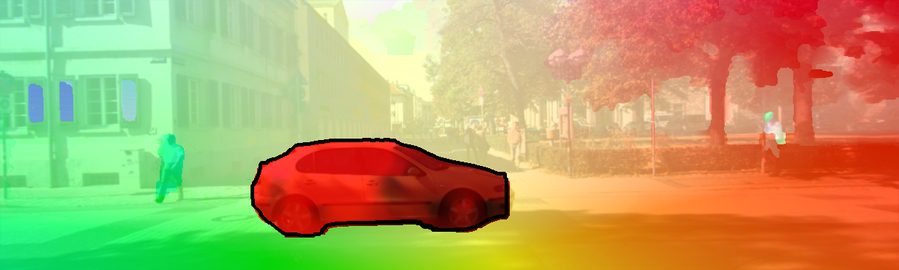
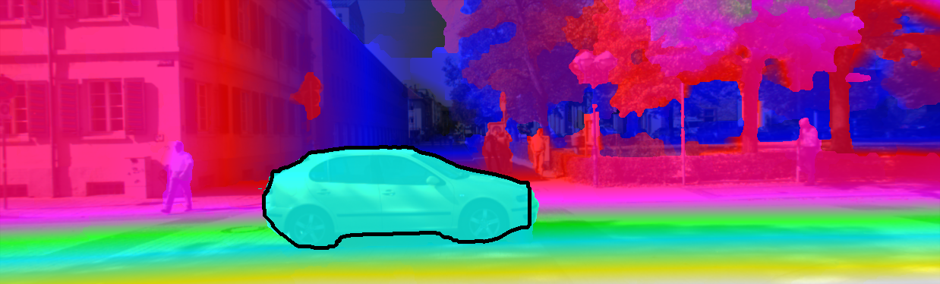
Cascaded Scene Flow Prediction using Semantic Segmentation
Zhile Ren Deqing Sun Jan Kautz Erik Sudderth

Slide 2
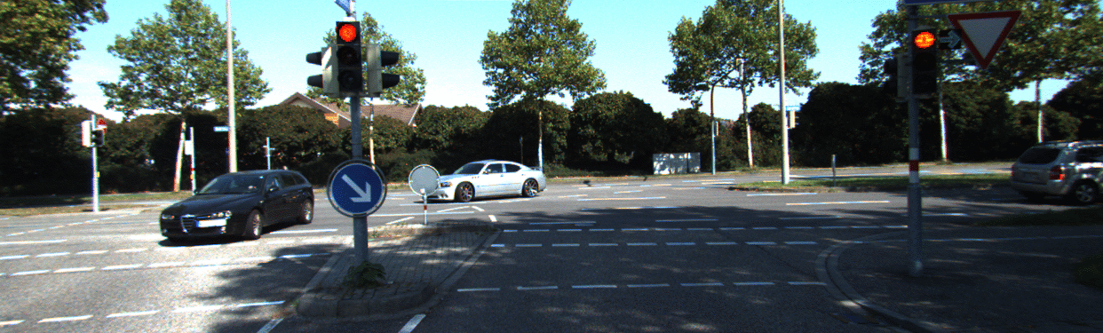

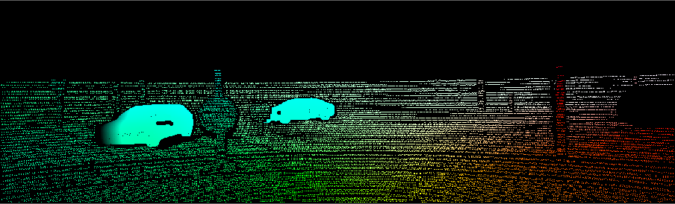
Optical Flow
Source:
KITTI Scene Flow 2015

Slide 3
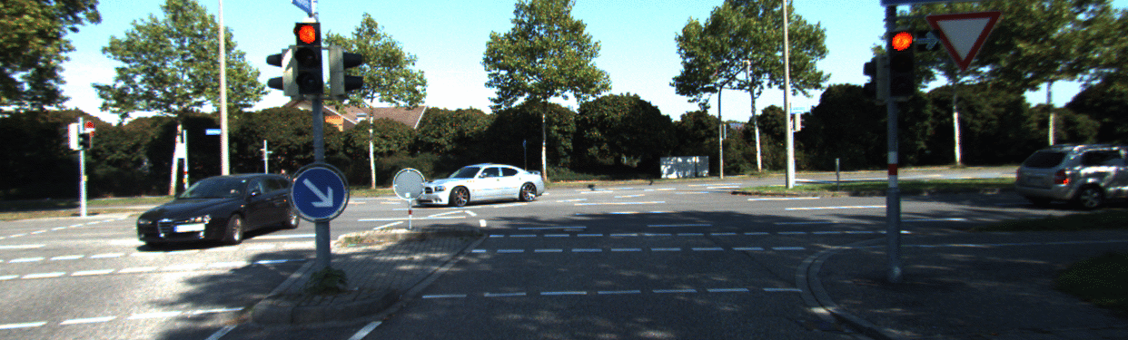
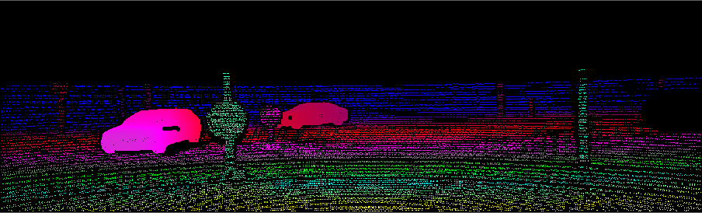
Stereo
Source:
KITTI Scene Flow 2015

Slide 4
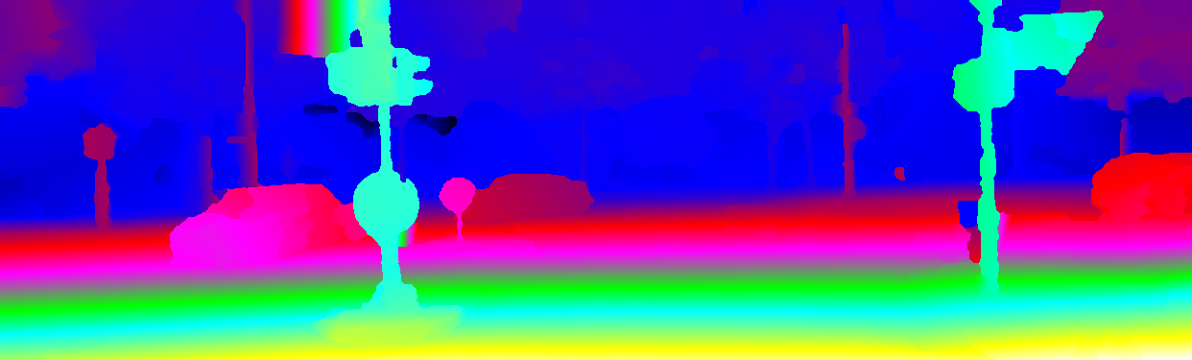
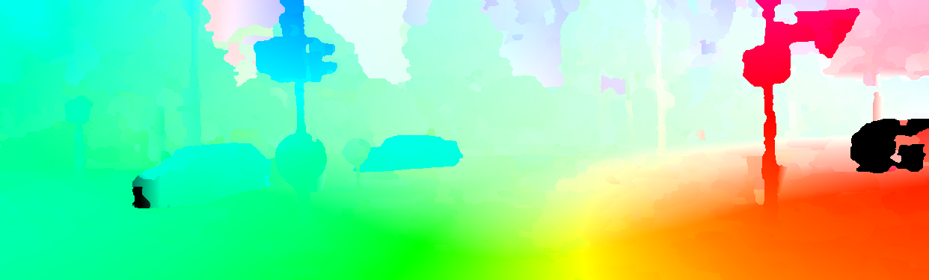
Scene Flow
Disparity
3D Motion
Flow
[Vogel et al., 2013]

Slide 5
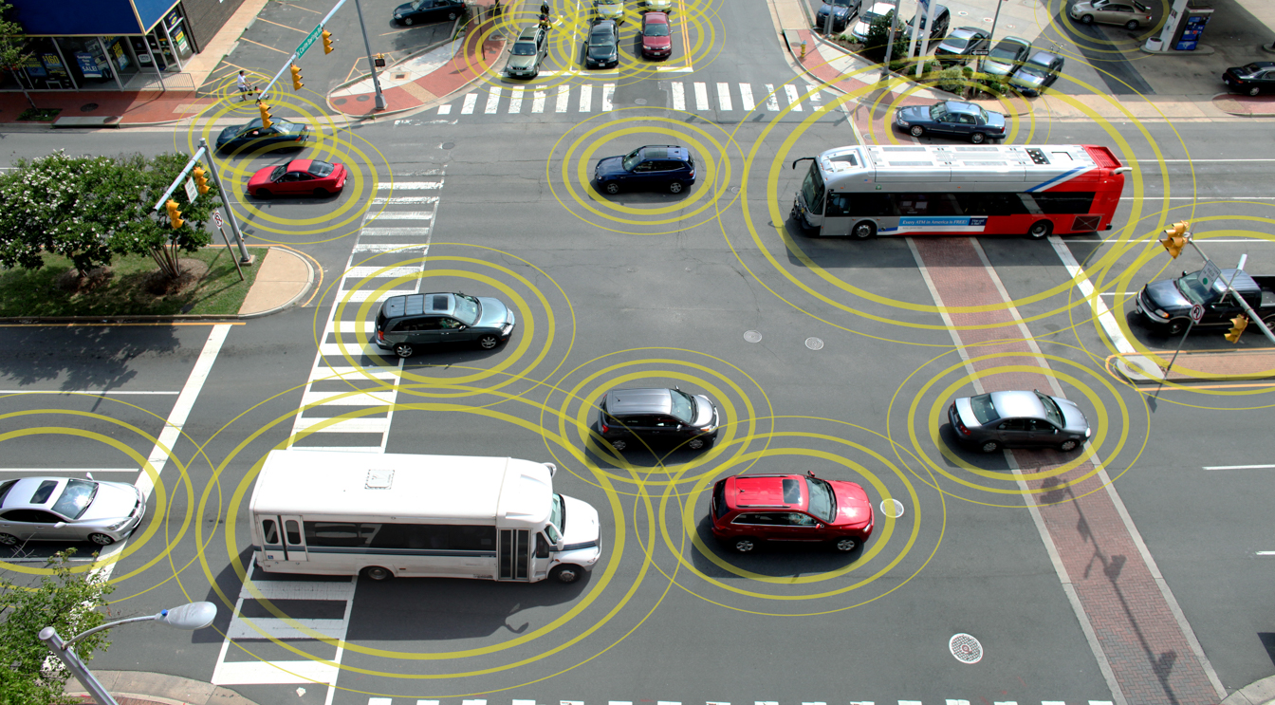
Scene Flow Applications
3D Motion Tracking
[Park et al., 2012]
Autonomous Driving

Slide 6
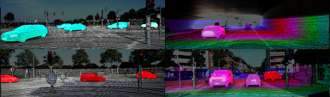
KITTI Dataset
200 Training/Test images, urban/city scenes
Flow/Stereo available, autonomous driving applications
Annotation: CAD models for cars. Laser scan data for background
[Menze et al., 2015]

Slide 7
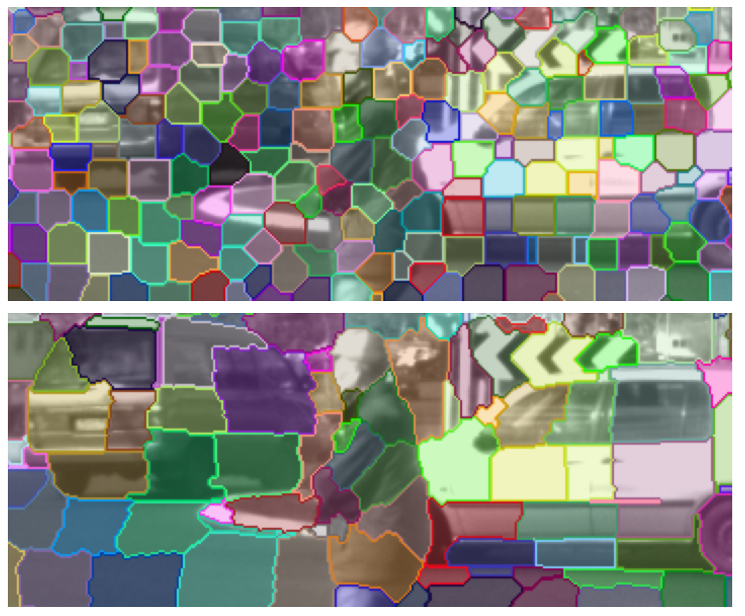
Piecewise Planar and Rigid Model
Piecewise Rigid Scene Flow (PRSF)
[Vogel et al., 2013]:
Superpixels: Planar geometry, rigid motion
Similar geometry/motion → large segment
Cons:
Foreground objects: Not always planar
Superpixels: Not semantically meaningful
[Vogel et al., 2013]

Slide 8
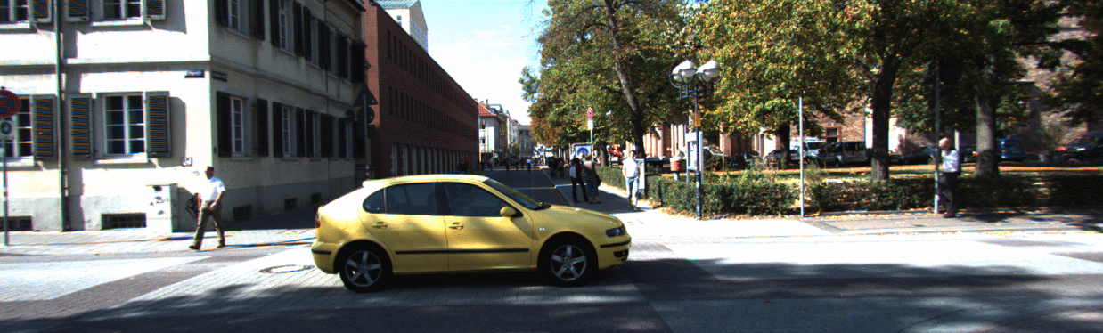
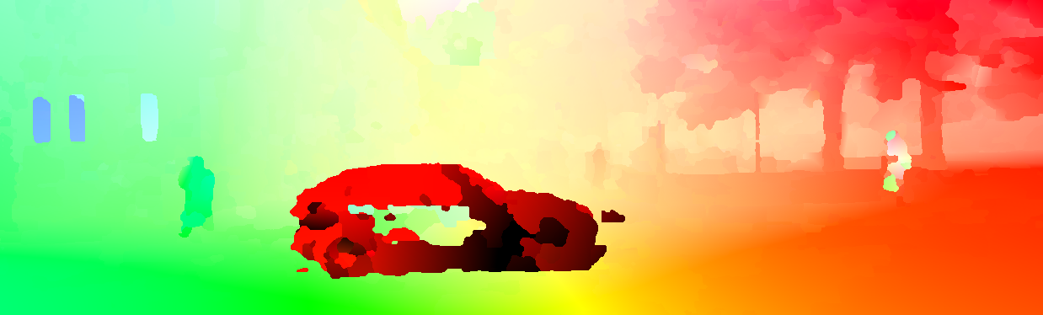

Our Goal: Semantic Scene Flow
Optical Flow Initialization (PRSF)
Disparity Initialization (PRSF)

Slide 9
Our Goal: Semantic Scene Flow
Improve scene flow using semantic information.
Optical Flow Estimation
Disparity Estimation

Slide 10
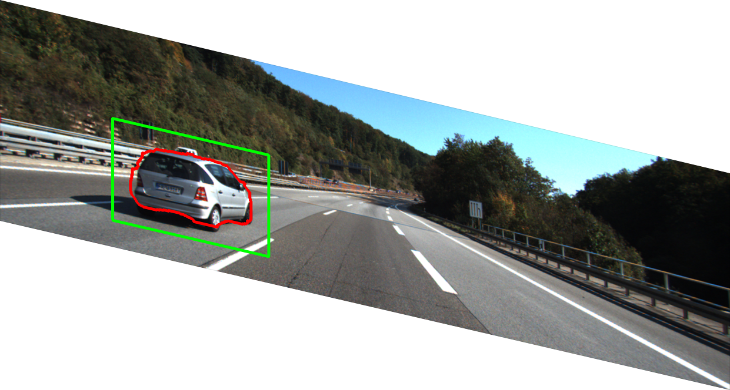
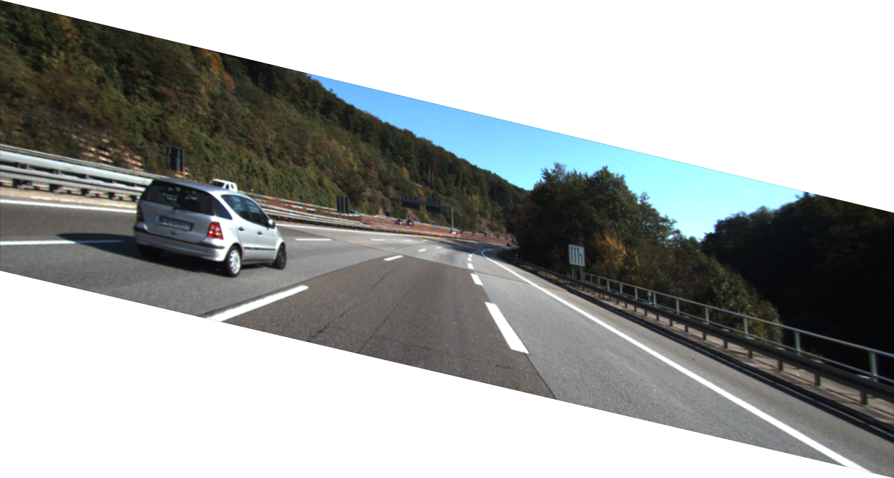

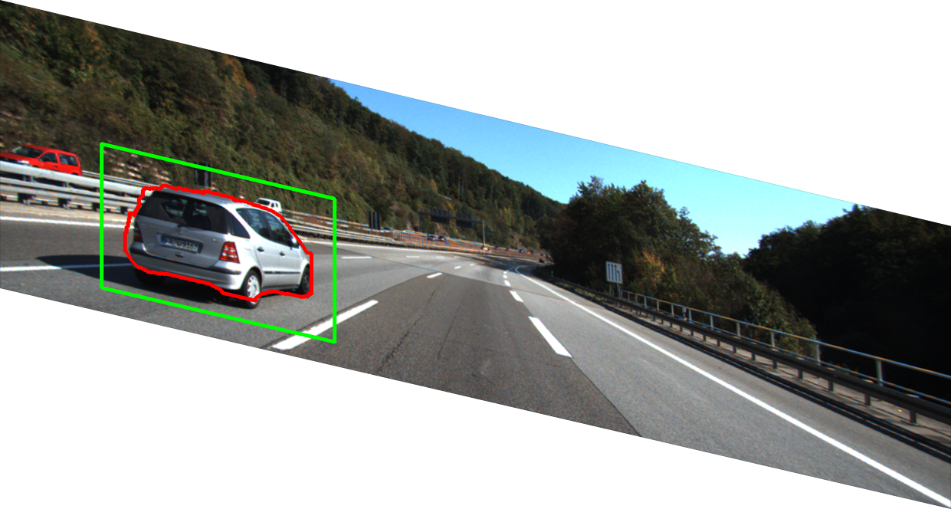
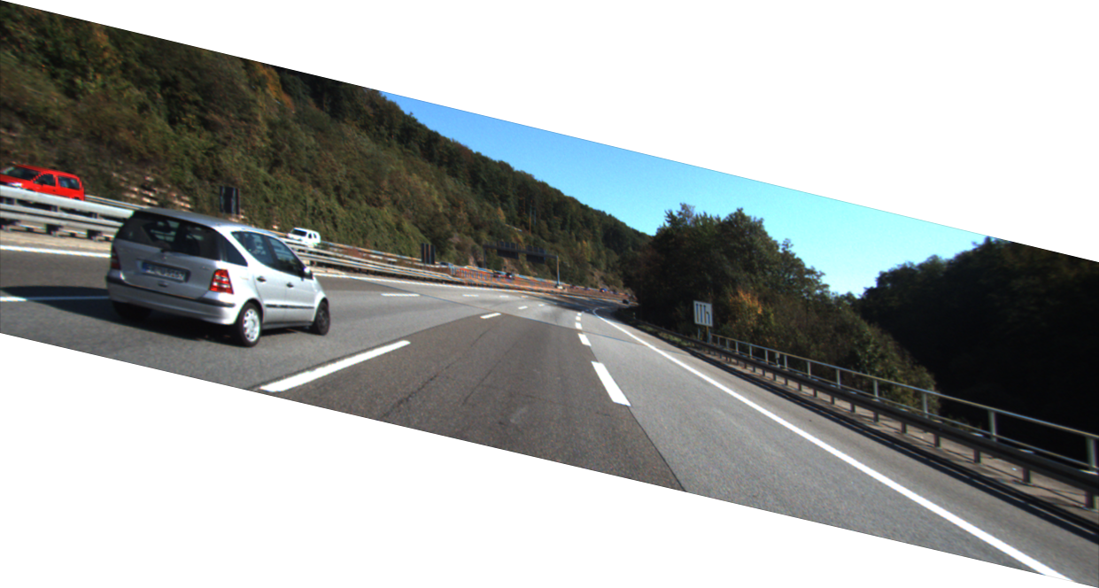
Overview of Semantic Scene Flow
Left
Right
Reference Frame

Slide 11
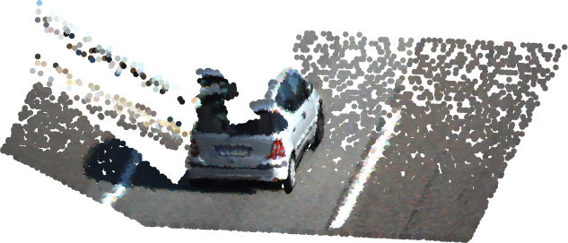
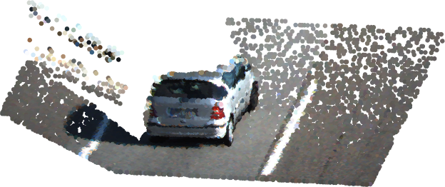
Overview of Semantic Scene Flow
Initial Geometry
Initial Flow
Updated Geometry
Updated Flow

Slide 12
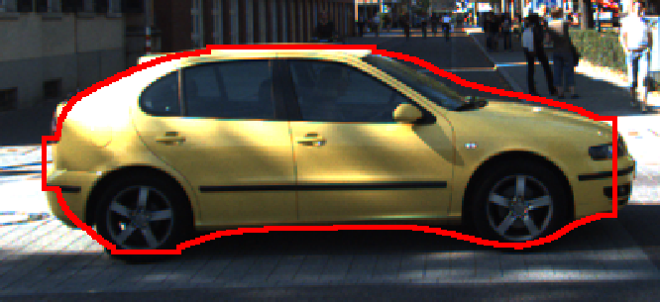
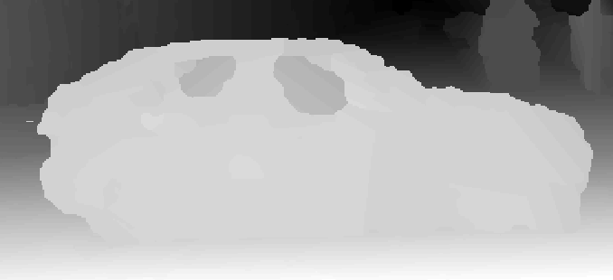
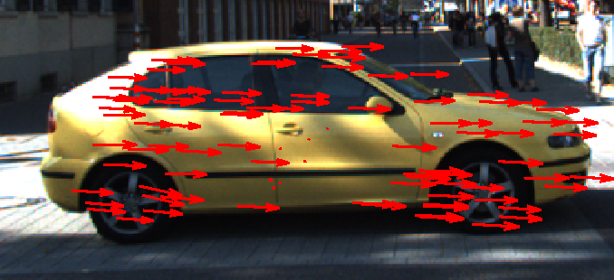

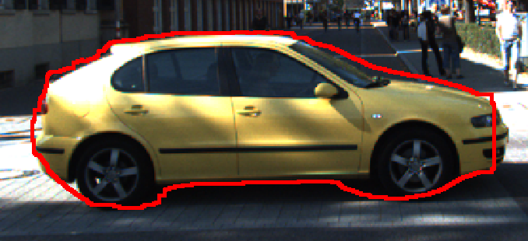
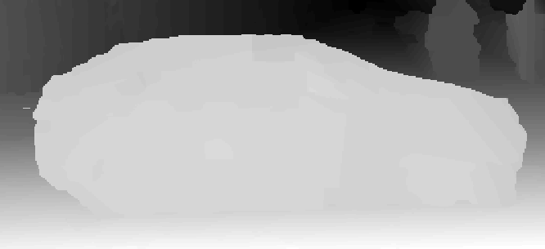
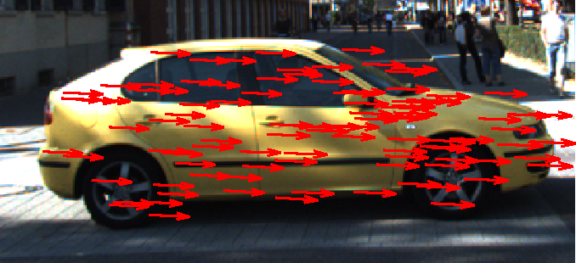



Segmentation, Depth, Motion and Flow
[Dai et al., 2016]
[Vogel et al., 2013]
[Vogel et al., 2013]
Cascade 1
Cascade 2

Slide 13
Optimize Global Energy Function
Segmentation
Cascaded Prediction [Heitz et al., 2008]:
Can be viewed as blocked coordinate descent
Geometry
Motion
Flow

Slide 14
Refinement of Semantic Segmentation
Segmentation
Geometry
Motion
Flow

Slide 15
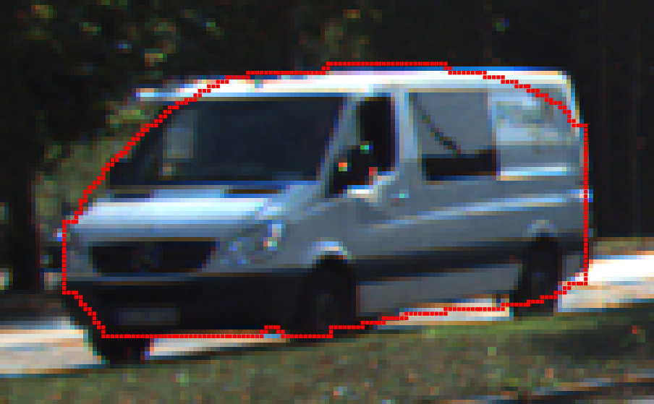
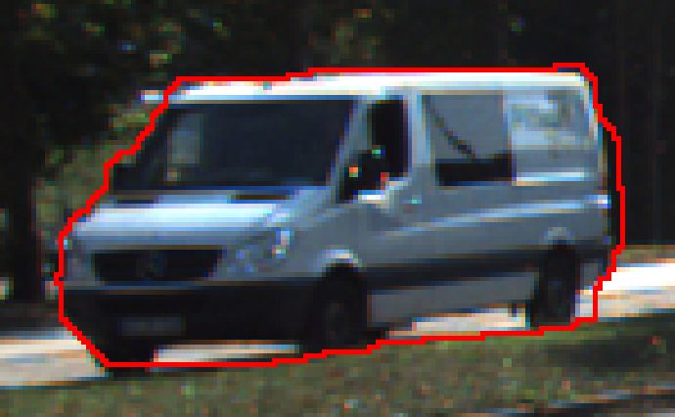
Refinement of Semantic Segmentation
Unary Energy
  Penalize label disagreement to initial segmentation
  Tolerate label disagreement for border pixels
Spatial Energy:
  Penalize inconsistent color & depth
[Dai et al., 2016]
Inference: Tree-Reweighted BP
Parameter learning: Structured SVM
Refined
segmentation
Notes:
“Standard formulation” instead of “classical” “traditional”

Slide 16
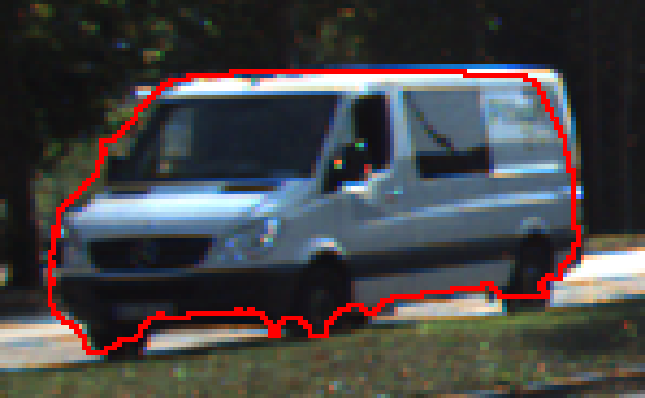
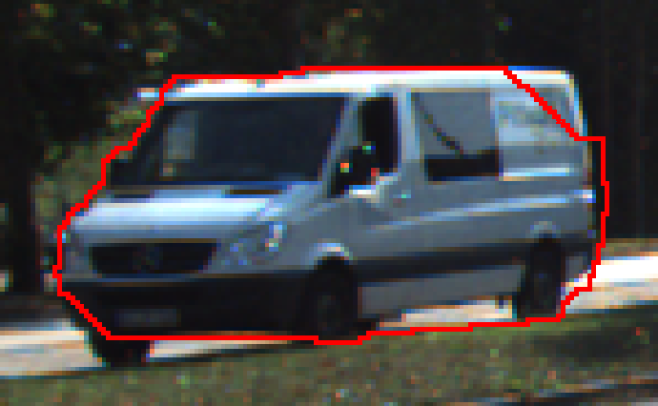
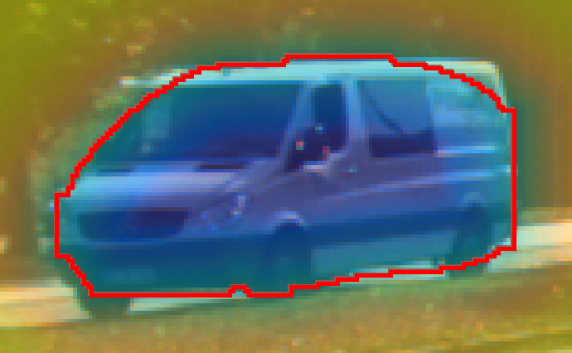
Modeling Segmentation Borders
Segmentation
annotation.
Without border pixel modeling
Signed distance
to border
With border pixel modeling
Notes:
Re-arrange order.

Slide 17
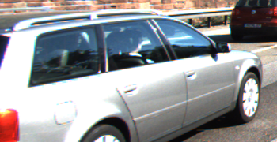
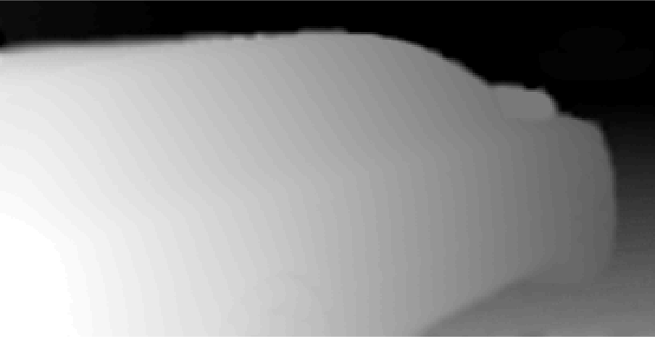
Estimation of Scene Geometry
Segmentation
Geometry
Motion
Flow

Slide 18
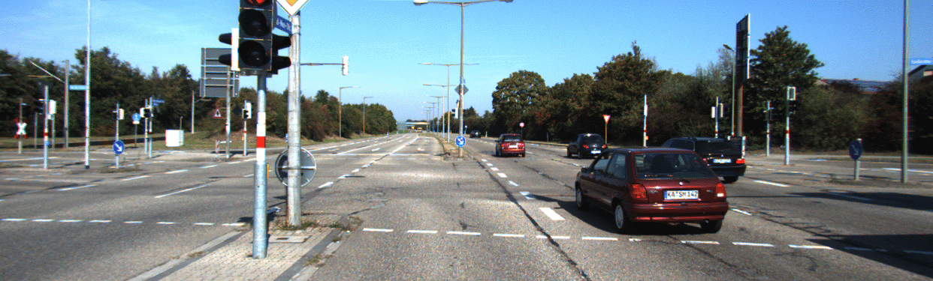
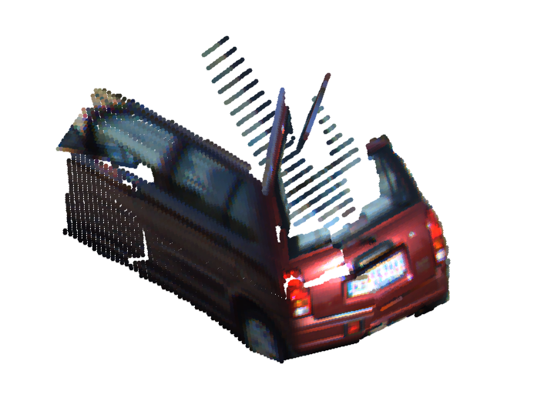

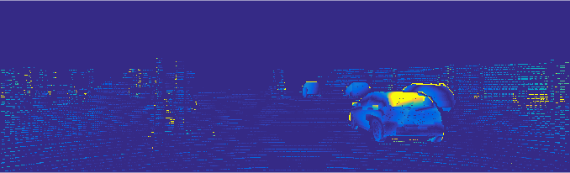
Estimation of Scene Geometry
Stereo Input
Initial Geometry [Vogel et al., 2013]
Object Mask
Initial Disparity Error

Slide 19
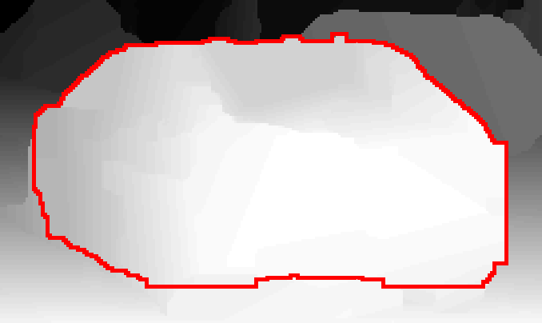
Estimation of Scene Geometry
Unary Energy:
  Penalize left-right image patch difference
Pairwise Energy:
  Penalize depth difference (L1 norm)
Inference:
  Efficient message passing using distance transformation [Felzenszwalb & Huttenlocher]
  Inference time: < 5s (256 labels, 20,000 nodes)
Depth Map

Slide 20
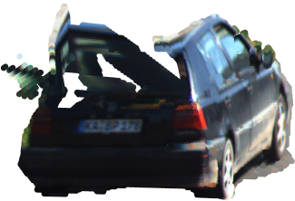


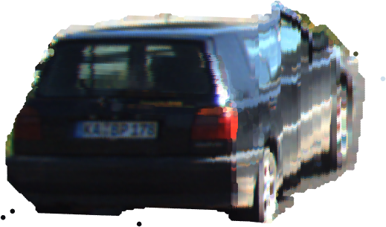
Estimation of Scene Geometry
Disparity Error
Initial Geometry
Disparity error
for refined geometry
Refined Geometry
Reconstructed 3D Point Clouds

Slide 21
Estimation of 3D Rigid Motion
Segmentation
Geometry
Motion
Flow

Slide 22
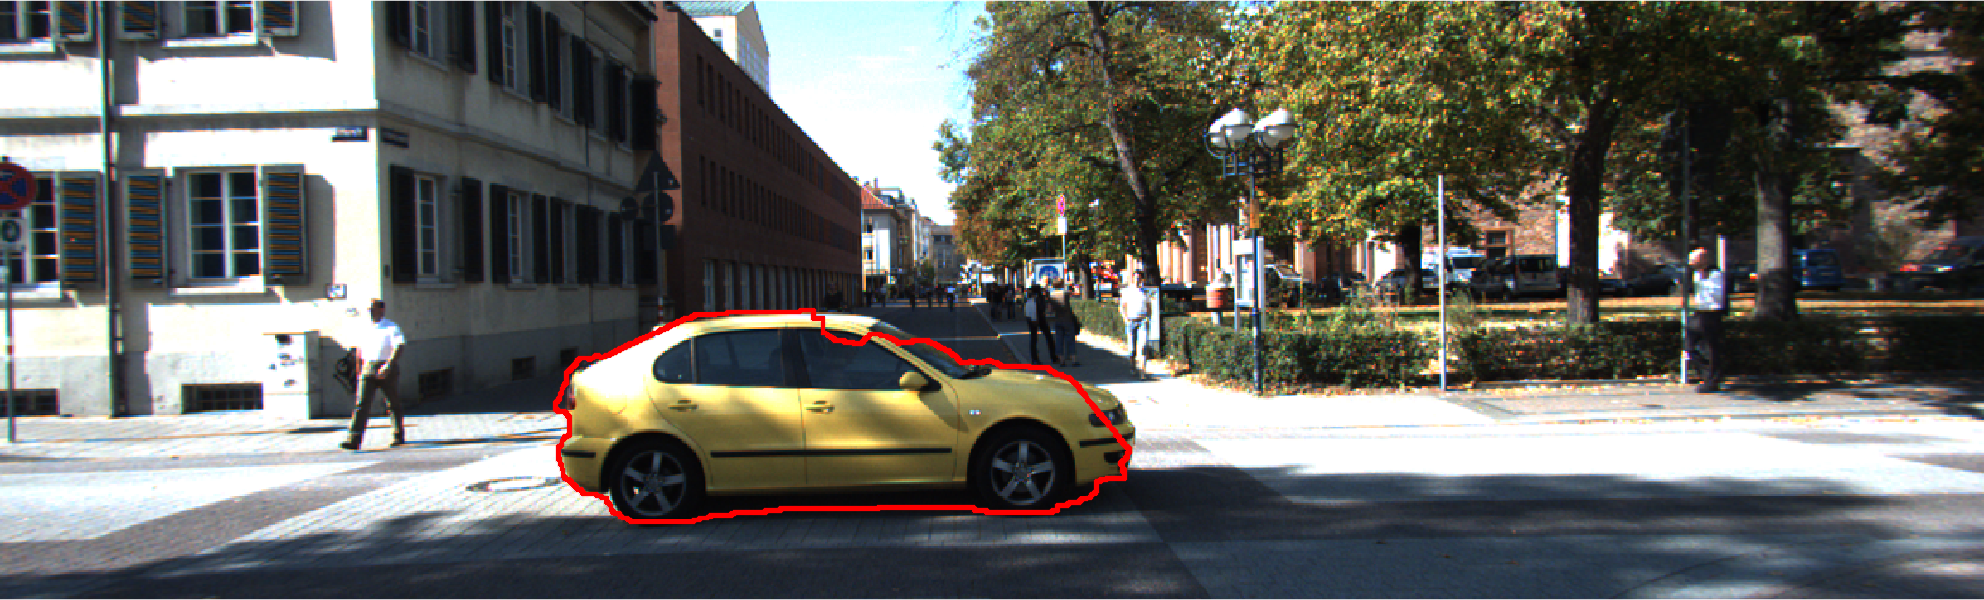
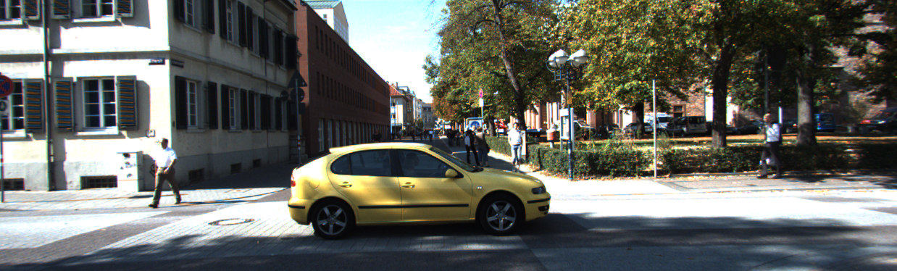
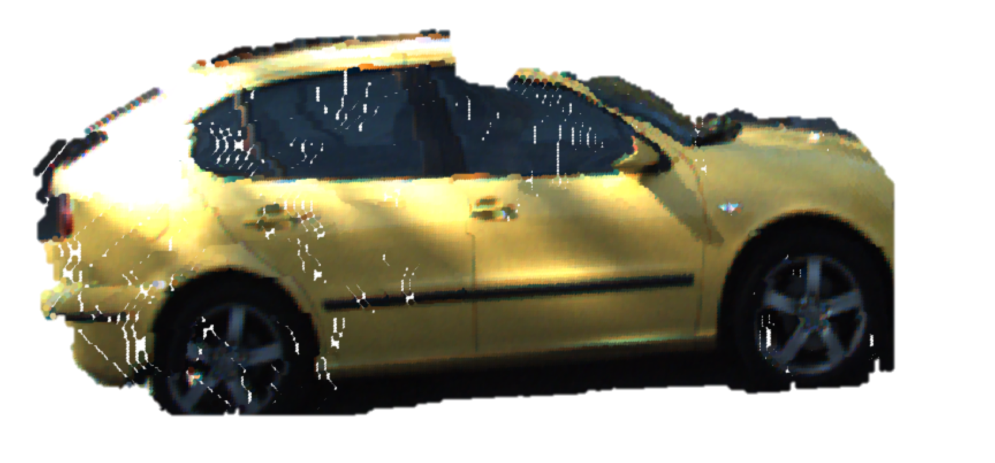
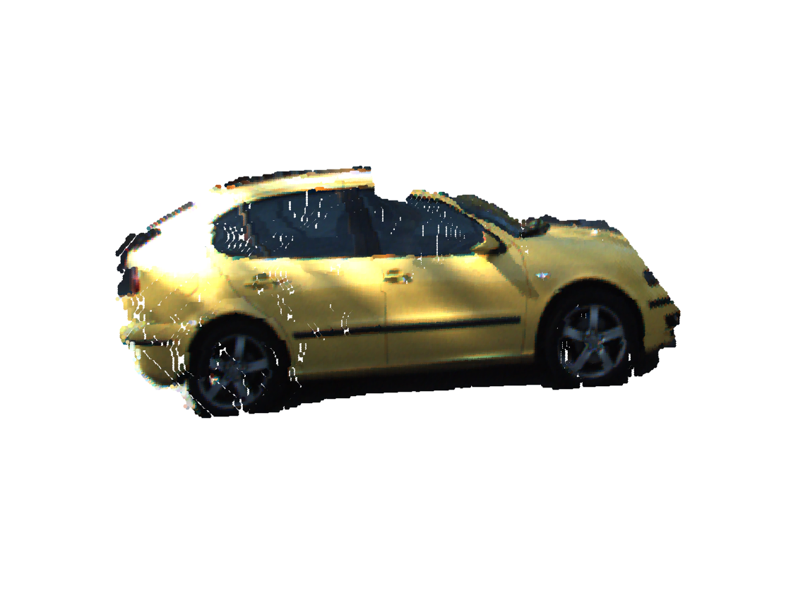
Estimation of 3D Rigid Motion
Frame 1
Frame 2
Motion Flow
Notes:
3d point cloud.

Slide 23
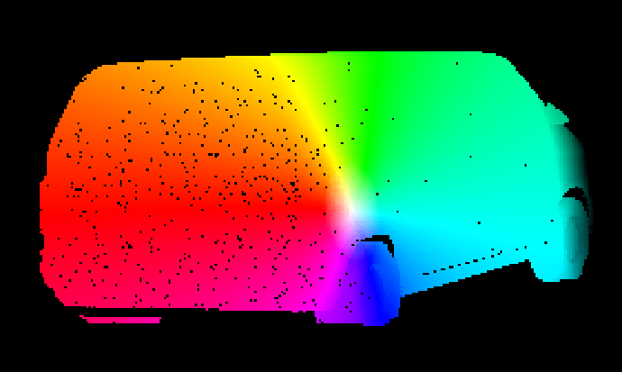

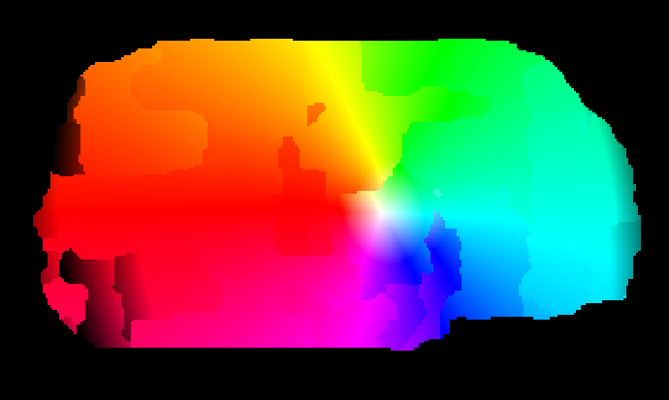
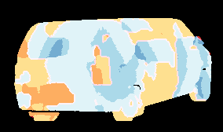
Estimation of 3D Rigid Motion
Frame 1
GT Flow
Estimated Flow
[Vogel et al., 2013]
Flow Error
Notes:
Color bar

Slide 24
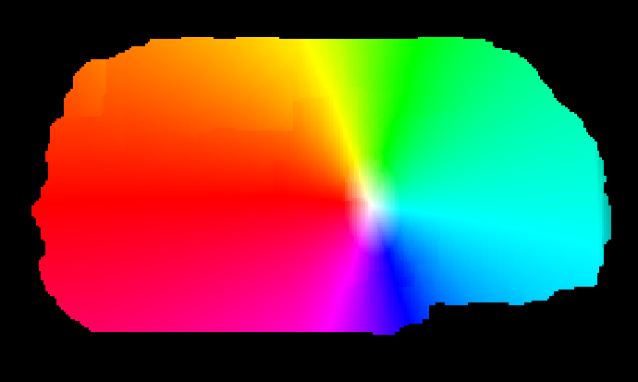

Estimation of 3D Rigid Motion
Rotation angle should be small
Motion should match 2D optical flow.
Initial flow Error
Motion flow Error

Slide 25
Optimize Global Energy Function
Segmentation
Geometry
Motion
Flow

Slide 26
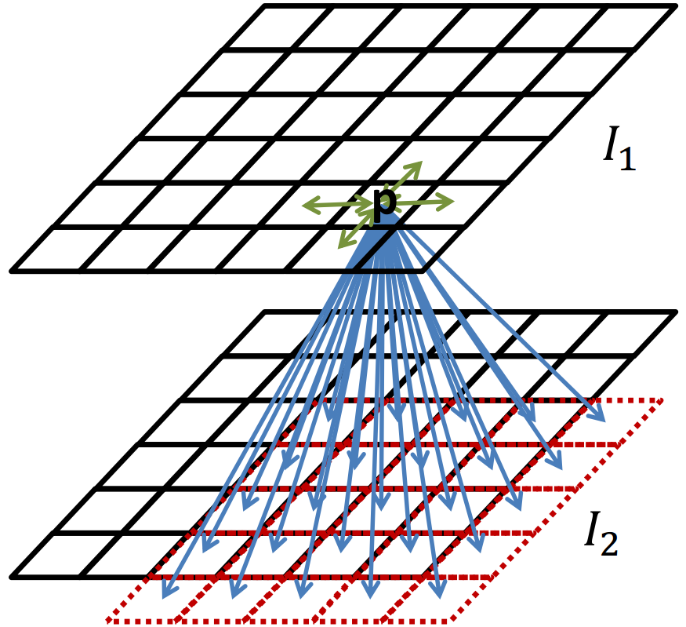
Estimation of 2D Optical Flow
Unary Energy:
  Penalize patch difference between frames
  Penalize large deviation from 3D motion
Pairwise Energy:
  Flow difference between nodes. (L1 Norm)
Inference:
  Efficient message passing using distance transformation
  Efficient implementation for optical flow [Felzenszwalb & Huttenlocher, 2006] [Chen & Koltun, 2016]
[Source: Chen et al., 2016]

Slide 27
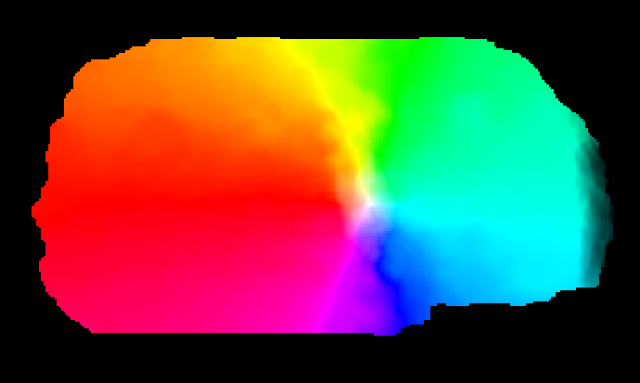
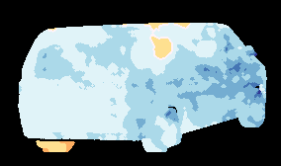
Estimation of 2D Optical Flow
Motion Flow
Motion Flow Error
Estimated Flow
Estimated Flow Error

Slide 28
Optimize Global Energy Function
Segmentation
Geometry
Motion
Flow

Slide 29
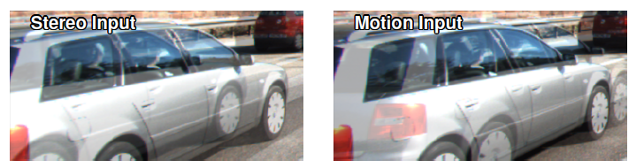


Cascaded Scene Flow Prediction
Add temporal consistency for segmentation and disparity
First Frame
Optical Flow
Second Frame
Disparity
Disparity
Iteration 1
Iteration 2

Slide 30
Experiment Results
Scene Flow Evaluation on KITTI 2015 test set:
D1: Percentage of stereo disparity outliers in first frame
bg: Percentage of outliers averaged only over background regions
fg: Percentage of outliers averaged only over foreground regions
all: Percentage of outliers averaged over all ground truth pixels
Notes:
Add labelings and explainations.

Slide 31
Experiment Results
Scene Flow Evaluation on KITTI 2015 test set:
Fl: Percentage of optical flow outliers
bg: Percentage of outliers averaged only over background regions
fg: Percentage of outliers averaged only over foreground regions
all: Percentage of outliers averaged over all ground truth pixels
Notes:
“published” instead of “existing”

Slide 32





Scene Flow Prediction
Stereo Input
Motion Input
Disparity Input
Flow Input
Updated Disparity
Updated Flow

Slide 33




Scene Flow Prediction
Stereo Input
Motion Input
Initial Disparity Error
Initial Flow Error
Updated Disparity Error
Updated Flow Error

Slide 34





Scene Flow Prediction
Stereo Input
Motion Input
Disparity Input
Flow Input
Updated Disparity
Updated Flow

Slide 35




Scene Flow Prediction
Stereo Input
Motion Input
Initial Disparity Error
Initial Flow Error
Updated Disparity Error
Updated Flow Error

Slide 36





Failure Case for Scene Flow Prediction
Stereo Input
Motion Input
Disparity Input
Flow Input
Updated Disparity
Updated Flow

Slide 37




Failure Case for Scene Flow Prediction
Stereo Input
Motion Input
Initial Disparity Error
Initial Flow Error
Updated Disparity Error
Updated Flow Error

Slide 38

Discussions: Concurrent Work
Instance Scene Flow (ISF)
[Behl et al., ICCV 2017]
Additional training data (~20x KITTI) for segmentation and disparity
2x slower than our method

Slide 39
Discussions: Importance of Segmentation
Performance improves over different iterations of the cascade
Better semantic segmentation enables better scene flow prediction

Slide 40
Conclusions
Improved scene flow prediction using semantic segmentation
Efficient computation speed using cascaded prediction
Optical Flow Estimation
Disparity Estimation
Thanks!

Slide 42

Experiment Results
Scene Flow Evaluation on KITTI 2015 test set:
D1: Percentage of stereo disparity outliers in first frame
D2: Percentage of stereo disparity outliers in second frame
Fl: Percentage of optical flow outliers
SF: Percentage of scene flow outliers (=outliers in either D0, D1 or Fl)
bg: Percentage of outliers averaged only over background regions
fg: Percentage of outliers averaged only over foreground regions
all: Percentage of outliers averaged over all ground truth pixels

Slide 43

Motion Estimation for Out-of-Frame Segments
Out-of-Frame pixels: Penalize large difference from motion flow.
In-Frame pixels: Choose the best among motion flow and estimated flow.

Slide 44

Recovering Poor Optical Flow Initialization

Slide 45
Graphical Model for Cascaded Prediction

Slide 46

Cascaded Prediction
Cascaded classifier (Heitz et al., 2008)
  Model first-stage detector as latent variables in directed graph.
  Marginalizing first-stage variables recovers fully-connected graph.

